Slide 1
Data Center Infrastructure CT109-3-2&Version 2
Cooling System Options and Environmental Control I & II

Slide 2
Topic & Structure of The Lesson
Cooling System Options and Environmental Control

Slide 3
Learning Outcomes
At the end of this module, YOU should be able to:
Demonstrate a knowledge of the fundamentals of cooling.
Understand what cooling options are available and the
advantages\disadvantages of each method, especially with respect to risk management.
Understand different monitoring and control strategies including associated benefits
Be aware of how to implement the changes in an operational environment.
Understand how cooling is affected by design considerations across the world.
Understand how to make cooling systems more efficient
Understand CoP/EER and operational efficiency across the whole lifecycle of the data centre including part load efficiency.

Slide 4
Key Terms You Must Be Able To Use
If you have mastered this topic, you should be able to use the following terms correctly in your assignments and exams:
Plenum feed
Plenum return
Direct Cooling
Closed Circuit

Slide 5
Cooling – great potential for savings
The cooling system of a data center is turning into a major design criterion. The continuous increase in processor performance is leading to a growing demand for energy, which in turn leads to considerably higher cooling loads. This means that it makes sense to cool partitioned sections in the data center individually, in accordance with the specific way heat is generated in the area.

Slide 6
Total facility power includes the energy used to power distribution switch board, the uninterruptible power supply (UPS), the cooling system, climate control and all IT equipment, i.e. computers, servers, and associated communication devices and peripherals.

Slide 7
Water Risk
An often neglected danger for IT systems is water. It is usually not a threat in the case of pipe leaks or floods, but represents a danger in the form of extinguishing water in the event of the above-discussed fire threats. The amage caused by the fire is often less severe than the damage caused by the water used to extinguish it.
The latest developments allow data centers to be equipped with wireless sensors that are able to detect leaks early, send warning signals and automatically close doors if required. This is particularly important when highly efficient liquid-cooling systems are used for racks.

Slide 8
The data center is now divided up into an entrance area, the actual computer room and a work area for administrators, right through to separate rooms for UPS batteries, emergency power generators and cooling. In addition, attention must be given to matters like access control, video monitoring and alarm systems. An emphasis on active and passive components requires an improved infrastructure that includes such equipment as a cooling system and power supply, which in turn affect installation and construction as well as the data cabling structure.

Slide 9
Room Concepts
Different room concepts exist with regard to data center layout.
The classical Room-in-Room Concept with separate technical and IT security rooms that house any type and number of server racks and network cabinets is equipped with raised floors, dropped ceilings if necessary, active and passive fire protection and a cooling system.

Slide 10
Core Layer / Backbone
The Core Layer in the hierarchical design is the high-speed “backbone” of the network. This layer is critical for connectivity between the devices in the Aggregation Layer, which means that devices in this layer must also have high availability and be laid out redundantly.
Due to the severe load placed on Core Switches, they have a tendency to generate higher process heat than Access or Aggregation Switches; therefore one must make certain that sufficient cooling is provided for them. Many Core Switches offer the ability to replace fans without having to turn off the switch.

Slide 11
Pod Systems
Pod systems are a group (12 to 24) of self-contained rack systems. They are highly optimized and efficiently constructed with regard to power consumption, cooling performance and cabling, so as to enable rapid replication. In addition, each pod system can be monitored and evaluated.

Slide 12
Data Center Infrastructure
Placing cabinets in rows makes for arrangements that are advantageous for cooling active components. One must make sure that aisles have sufficient space to allow for installing and dismantling active components. Since active components in recent years are having continuously larger installation depths, an aisle width of at least 1.2 meters must be provided.

Slide 13
Cooling
Every kilowatt (kW) of electrical power that is used by IT devices is later released as heat. This heat must be drawn away from the device, cabinet and room so that operating temperatures are kept constant.
Air conditioning systems, that operate in a variety of ways and have different levels of performance, are used to draw away heat. Providing air conditioning to IT systems is crucial for their availability and security. The increasing integration and packing densities of processors and computer/server systems causes a level of waste heat that was unimaginable in such a limited space only a few years ago.

Slide 14
In order to improve the performance of existing air conditioning solutions that use raised floors, containment is currently provided for active components, which are arranged in accordance with the cold aisle/hot aisle principle. Cold and hot aisles are sometimes enclosed in order to enable higher heat emissions per rack.
A cabling solution that is installed in a raised floor, and that is well-arranged and professionally optimized in accordance with space requirements, can likewise contribute to improved air conditioning.

Slide 15
The decision criteria for an air conditioning solution include, among other things, maximum expected dissipation loss, operating costs, acquisition costs, installation conditions, expansion costs, guaranteed future and costs for downtimes and for physical safety.
There are basically two common air conditioning types:
· Closed-circuit air conditioning
· Direct cooling

Slide 16
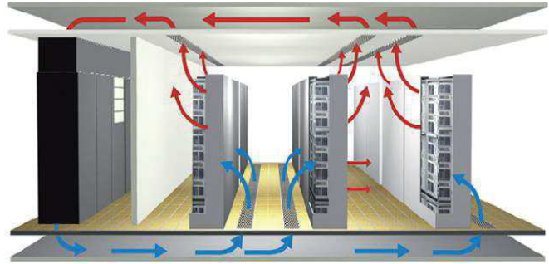
Closed-circuit air conditioning

Slide 17
Closed-Circuit Air Conditioning Operation
Conditions for supply air in the cold aisle should be between 18° C and 27° C, depending upon the application relative supply air humidity should be between 40% and 60% RH. Lower humidity leads to electrostatic charging, high humidity to corrosion of electrical and electronic components. Operating conditions with extremely cold temperatures of under 18° C and high humidity, which lead to formation of condensation on IT devices, must always be avoided. A maximum temperature fluctuation of 5° C per hour must also be taken into consideration.

Slide 18
In the closed-circuit air conditioning principle, the air cooled by the air conditioning system circulates to IT components, takes in heat and the warmed air then reaches the air conditioning system again in the form of return air that is to be re-cooled. Only a small amount of outside air is introduced into the room that is to be air conditioned and used for air exchange. Optimal conditions with respect to temperature and relative humidity can only be achieved with closed-circuit air-conditioning units, or so-called precision air-conditioning units. The energy used in these systems is better utilized, i.e. reducing the temperature of return air is the first priority.

Slide 19
Plenum Feed, Plenum Return
In “Plenum Feed, Plenum Return”, it is absolutely necessary that the cabinet has doors and that they can be sealed airtight. By contrast, the floor must be sealed on the warm side and be open on the cold side. These solutions are suitable for power of approximately 15 kW.

Slide 20
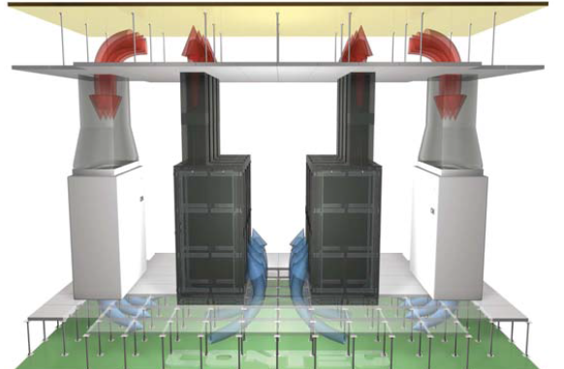
Plenum Feed, Plenum Return

Slide 21
Within the cabinet no openings may exist between the cold side and the warm side, to ensure that mixtures and microcirculations are avoided. Unused height units and feed through should be closed with blind panels and seals.
Performance can be further optimized by containment of the cold or warm aisle

Slide 22
Direct-Cooling Principle – Water-Cooled Server Rack
Direct cooling of racks must be implemented when heat loads exceed 10 to 15 kW per cabinet. This is realized via a heat exchanger installed in the immediate vicinity of the servers. These are usually heat exchangers cooled with cold water, that are arranged either below or next to the 19” fixtures. Up to 40 kW of heat per rack can be drawn off in this way. A cold-water infrastructure must be provided in the rack area for this method.

Slide 23
Direct-Cooling Principle – Water-Cooled Server Rack
The water-cooled racks ensure the proper climatic conditions for their server cabinets, and are therefore self-sufficient with respect to the room air-conditioning system. In buildings with a low distance between floors, water-cooled server racks are a good option for drawing off high heat loads safely without having to use a raised floor. The high-performance cooling system required for higher power also includes a cold and hot aisle containment.

Slide 24
Quick Review Question
Briefly explain two common air conditioning types
What is plenum feed and plenum return?

Slide 25
Summary of Main Teaching Points
Discussed Cooling System Options and Environmental Control

Slide 26
Question and Answer Session
Q & A

Slide 27
What we will cover next
Electrical Power Systems I

